Slide 1
Chapter 14: Basics of Functional Dependencies and Normalization for Relational Databases

Slide 2
Introduction
Lecture 5 > Section 1 > Overview
So far we have assumed:
Attributes are grouped to form a relation schema by using the common sense of the database designer
Need some formal way of analyzing why one grouping of attributes into a relation schema may be better than another
In this chapter we discuss some of the theory to evaluate relational schemas for design quality

Slide 3
What Are Some Database Schema Better Than Others
Lecture 5 > Section 1 > Overview
Consider the following a very simple way to design a database schema:
Put every attribute that you need to store into one single (huge) relation.
Example: the University database schema will become:
This relation is called the Universal Relation
So what is bad about this relation?

Slide 4
What Makes a Relation “Good” or “Bad”?
Lecture 5 > Section 1 > Overview
Four informal guidelines: measures to determine the quality of relation schema design:
Making sure that the semantics of the attributes is clear in the schema
Reducing the redundant information in tuples
Reducing the NULL values in tuples
Disallowing the possibility of generating spurious tuples

Slide 5
Imparting Clear Semantics to Attributes in Relations
Lecture 5 > Section 1 > Overview
Making sure that the semantics of the attributes is clear in the schema
Design a relation schema so it is easy to explain its meaning
Do not combine attributes from multiple entity types and relationship types into a single relation.
If the relation corresponds to a mixture of multiple entities, semantic ambiguities will result, and the relation cannot be easily explained
Notes:
Intuitively, if a relation schema corresponds to one entity type or one relationship type, it is straightforward to explain its meaning.

Slide 6
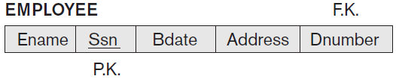
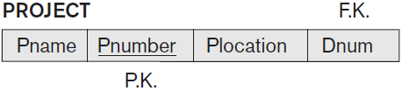

Imparting Clear Semantics to Attributes in Relations (Example)
Lecture 5 > Section 1 > Overview

Slide 7
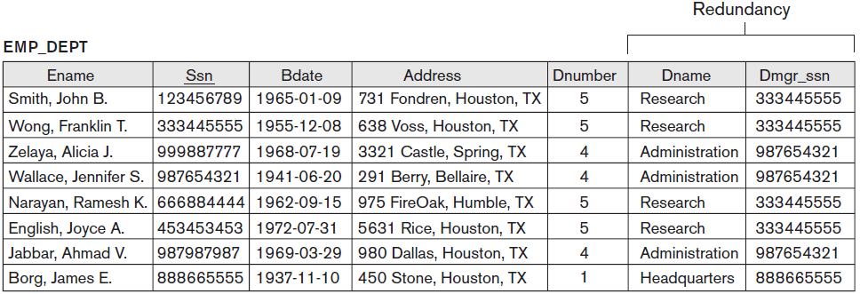
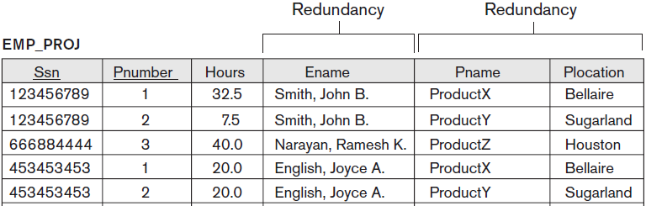
Redundant Information in Tuples
Lecture 5 > Section 1 > Overview
Notes:
1. In contrast, each department’s information appears only once in the DEPARTMENT relation in Figure 14.2. Only the department number (Dnumber) is repeated in the EMPLOYEE relation for
each employee who works in that department as a foreign key.

Slide 8
Update Anomalies
Lecture 5 > Section 1 > Overview
Storing such joins of base relations leads to an additional problem referred to as update anomalies
Database researchers has found a number of bad properties that they call anomalies
When a relation exhibits one or more of these "anomalies", it is deemed to be "bad"
There are three types of database anomalies:
Insert anomaly
Delete anomaly
Update anomaly

Slide 9
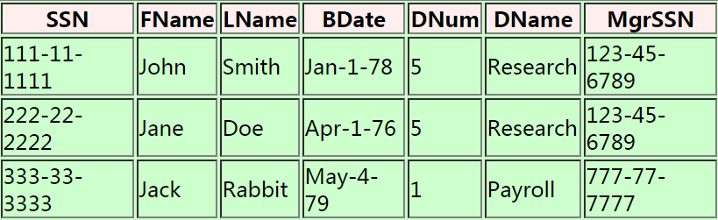
Insert Anomaly
Lecture 5 > Section 1 > Overview
See example:
If we insert a new tuple for an employee who works in department number 5
Must enter all the attribute values of department 5 correctly so that they are consistent with other tuples
Notes:
In the design of Figure 14.2, we do not have to worry about this consistency problem because we enter only the department number in the employee tuple; all other attribute values of department 5 are recorded only once in the database, as a single tuple in the DEPARTMENT relation.

Slide 10
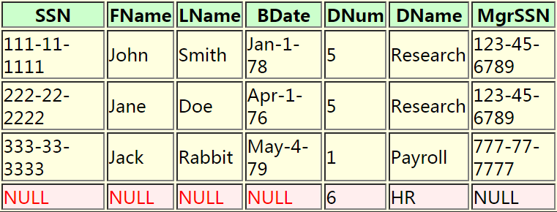
Insert Anomaly (cont.)
Lecture 5 > Section 1 > Overview
See example:
If we insert a department, say (dnumber=6, dname='Human Resources'), that does not have any employees, then we need to use NULL values
Notes:
This problem does not occur in the design of Figure 14.2 because a department is entered in the DEPARTMENT relation whether or not any employees work for it, and whenever an employee is assigned to that department, a corresponding tuple is inserted in EMPLOYEE.

Slide 11
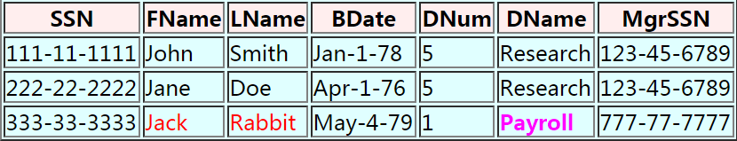
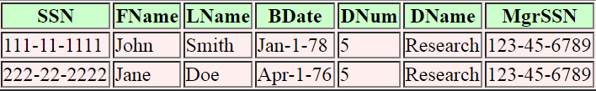
Delete Anomaly
Lecture 5 > Section 1 > Overview
See example:
If we delete the last employee "Jack Rabbit", we will lose information on the department
DELETE employee
WHERE fname = 'Jack' AND lname = 'Rabbit'
Notes:
In the design of Figure 14.2, we do not have to worry about this consistency problem because we enter only the department number in the employee tuple; all other attribute values of department 5 are recorded only once in the database, as a single tuple in the DEPARTMENT relation.

Slide 12
Delete Anomaly (cont.)
Lecture 5 > Section 1 > Overview
This delete operation has deleted additional information !!!
Information on the "Payroll" department is also deleted !!! (its dnumber, its name and its manager) from the database !!!
Clearly, that should not be a consequence of a delete command that is routinely used to remove employees....

Slide 13
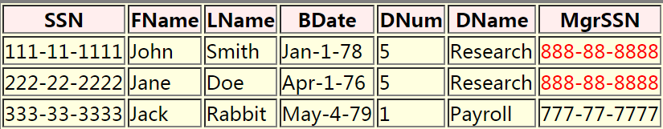
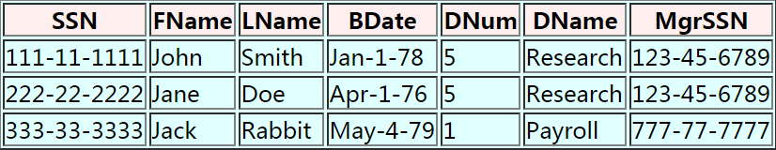
Update Anomaly
Lecture 5 > Section 1 > Overview
See example:
If we change the manager of the Research department to 888-88-8888
The update logically involved changing ONE item of information (namely change 123-45-6789 to 888-88-8888), but the update operation has modified multiple tuples in Employee

Slide 14
Constraints Prevent (some) Anomalies in the Data
Lecture 5 > Section 1 > Data anomalies & constraints
Is this form better?
Redundancy?
Update anomaly?
Delete anomaly?
Insert anomaly?
Student | Course
Mary | CS145
Joe | CS145
Sam | CS145
.. | ..
Course | Room
CS145 | B01
CS229 | C12
Today: develop theory to understand why this design may be better and how to find this decomposition…

Slide 15
Design Guideline 1
Lecture 5 > Section 1 > Overview
Design guideline 1:
Design the base relation schemas so that no insertion, deletion, or modification anomalies are present in the relations.
If any anomalies are present, note them clearly and make sure that the programs that update the database will operate correctly

Slide 16
Design Guideline 2
Lecture 5 > Section 1 > Overview
Design guideline 2:
As far as possible, avoid placing attributes in a base relation whose values may frequently be NULL.
If NULLs are unavoidable, make sure that they apply in exceptional cases only and do not apply to a majority of tuples in the relation

Slide 17
Design Guideline 3
Lecture 5 > Section 1 > Overview
Design guideline 3:
Avoid relations that contain matching attributes that are not (foreign key, primary key) combinations because joining on such attributes may produce spurious tuples.

Slide 18
Summary and Discussion of Design Guidelines
Lecture 5 > Section 1 > Overview
We have informally discussed situations that lead to problematic relation schemas
We proposed informal guidelines for a good relational design
In the rest: Present formal concepts that may be used to define the goodness and badness of relation schemas more precisely.
Discuss Functional dependency as a tool for analysis
Specify the three normal forms

Slide 19
Introduction to Functional Dependency
Lecture 5 > Section 1 > Overview
A formal tool for analysis of relational schemas
Enables us to detect and describe some of the above-mentioned problems in precise terms

Slide 20
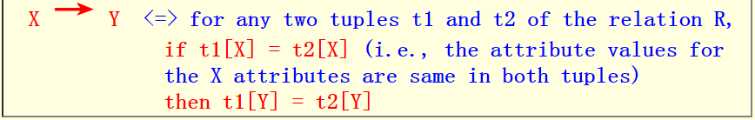
Functional Dependencies
Lecture 5 > Section 1 > Overview
Let X and Y be 2 set of attributes in a relation R
We say that Y is functionally dependent on X (or X functionally determines Y , notation: X → Y) iff:
See example:
Notes:
This means that the values of the Y component of a tuple in r depend on, or are determined by, the values of the X component; alternatively, the values of the X component of a tuple uniquely (or functionally) determine the values of the Y component

Slide 21
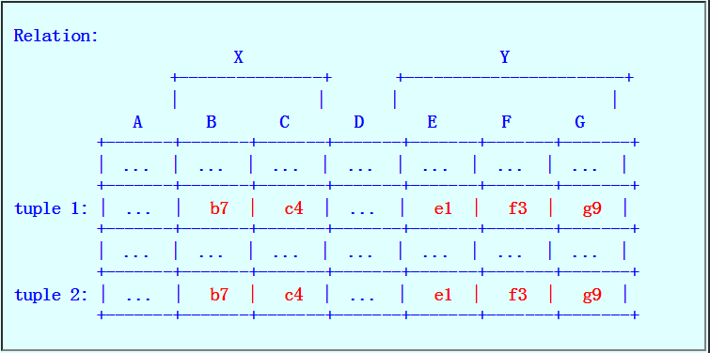
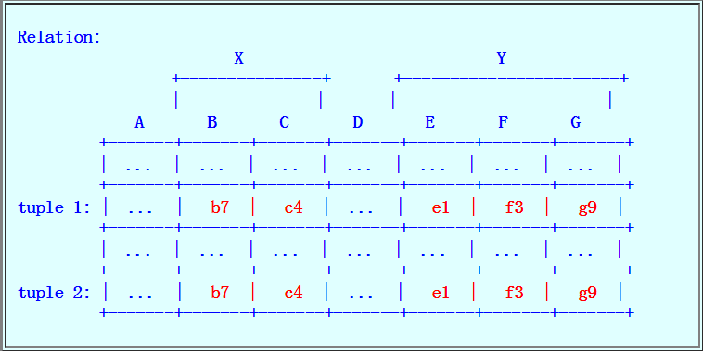
Functional Dependencies (cont.)
Lecture 5 > Section 1 > Overview
Example: A case where Y is not functionally dependent on X
What you must see if Y is functionally dependent on X

Slide 22
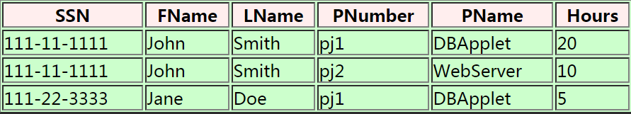
Example of Functional Dependencies
Lecture 5 > Section 1 > Overview
Consider the following relation:
That represent information about the employees AND the projects that they work on
The key of this relation is: (SSN, PNumber)
Sample content of the Employee1 relation:

Slide 23
Example of Functional Dependencies (cont.)
Lecture 5 > Section 1 > Overview
Some functional dependencies in the Employee1 relation:
SSN → fname, lname
PNumber → PName
SSN, PNumber → Hours
But also: SSN, PNumber → fname, lname !!!
And also: SSN, PNumber → PName !!!

Slide 24
Normal Forms
Lecture 5 > Section 1 > Overview
How to use functional dependencies to develop a formal methodology for testing and improving relation schemas
Takes a relation schema through a series of tests to certify whether it satisfies a certain normal form
1NF, 2NF and 3NF, which are based on primary keys

Slide 25
Normal Forms
Lecture 5 > Section 1 > Overview
1st Normal Form (1NF) = All tables are flat
2nd Normal Form (2NF)
Boyce-Codd Normal Form (BCNF)
3rd Normal Form (3NF)
4th and 5th Normal Forms = see text books
DB designs based on functional dependencies, intended to prevent data anomalies
Notes:
Having introduced functional dependencies, we are now ready to use them to specify how to use them to develop a formal methodology for testing and improving relation schemas.

Slide 26
The First Normal Form (1NF)
Lecture 5 > Section 1 > Overview
The 1NF is the simplest and the only one that does not depend on the notion of "functional dependency“
A relation is in 1NF (first normal form) if:
Every attribute of the relation has atomic (single, not multi) values

Slide 27
1st Normal Form (1NF)
Lecture 5 > Section 1 > Overview
Student | Courses
Mary | CS145
Mary | CS229
Joe | CS145
Joe | CS106
Student | Courses
Mary | {CS145,CS229}
Joe | {CS145,CS106}
… | …
Violates 1NF.
In 1st NF
1NF Constraint: Types must be atomic!

Slide 28
Full Functional Dependency
Lecture 5 > Section 1 > Overview
X → Y is a full functional dependency if removal of any attribute A from X means that the dependency does not hold anymore
That is, for any attribute A ε X, (X − {A}) does not functionally determine Y.
Example: {Ssn, Pnumber} → Hours is a full dependency
{Ssn, Pnumber} → Ename is partial dependency
2NF is based on the concept of full functional dependency
Notes:
That is, for any attribute A ε X, (X − {A}) does not functionally determine Y.
A functional dependency X → Y is a partial dependency if some attribute A ε X can be removed from X and the dependency still holds; that is, for some A ε X, (X − {A}) → Y.

Slide 29
The Second Normal Form (2NF)
Lecture 5 > Section 1 > Overview
A relation is in 2NF iff:
Relation is in 1NF (i.e., every attribute is atomic), and
Every non-key attribute is fully functionally determined by every key of the relation
In other words
Notes:
That is, for any attribute A ε X, (X − {A}) does not functionally determine Y.
A functional dependency X → Y is a partial dependency if some attribute A ε X can be removed from X and the dependency still holds; that is, for some A ε X, (X − {A}) → Y.

Slide 30
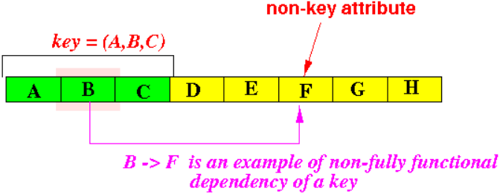
The Second Normal Form (2NF) (cont.)
Lecture 5 > Section 1 > Overview
How to spot the fact that a relation violates the 2NF
Find a non-key attribute that is functionally determined by a subset of some key
Graphically:
This will make the relation violates the 2NF criteria.
Notes:
That is, for any attribute A ε X, (X − {A}) does not functionally determine Y.
A functional dependency X → Y is a partial dependency if some attribute A ε X can be removed from X and the dependency still holds; that is, for some A ε X, (X − {A}) → Y.

Slide 31
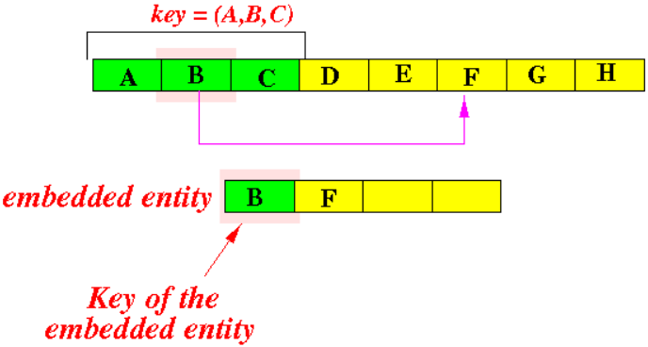
Meaning of the 2NF
Lecture 5 > Section 1 > Overview
The 2NF deals with embedded entities:
A relation that violates the 2NF contains another embedded autonomous entity
There may be other attributes (besides F) that are functionally dependent on B !!!
Notes:
That is, for any attribute A ε X, (X − {A}) does not functionally determine Y.
A functional dependency X → Y is a partial dependency if some attribute A ε X can be removed from X and the dependency still holds; that is, for some A ε X, (X − {A}) → Y.

Slide 32
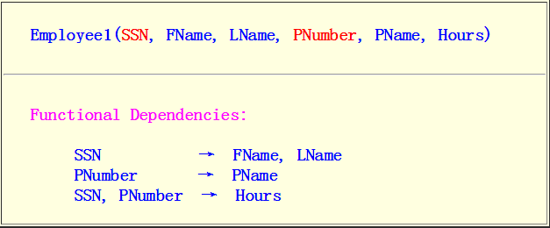
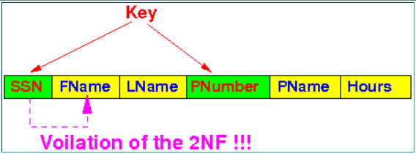
Example of a Violation of the 2NF
Lecture 5 > Section 1 > Overview
Consider the following relation:
Keys: (SSN, PNumber)
Employee1 is not in 2NF because of the following 2NF violation:
Notes:
That is, for any attribute A ε X, (X − {A}) does not functionally determine Y.
A functional dependency X → Y is a partial dependency if some attribute A ε X can be removed from X and the dependency still holds; that is, for some A ε X, (X − {A}) → Y.

Slide 33
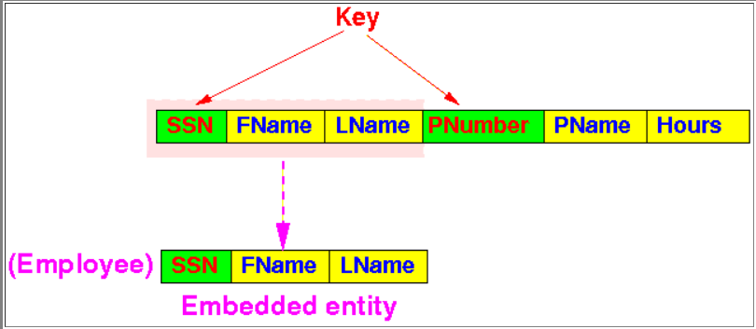
Example of a Violation of the 2NF (cont.)
Lecture 5 > Section 1 > Overview
The entity that is embedded inside this relation is Employee:
Notes:
That is, for any attribute A ε X, (X − {A}) does not functionally determine Y.
A functional dependency X → Y is a partial dependency if some attribute A ε X can be removed from X and the dependency still holds; that is, for some A ε X, (X − {A}) → Y.

Slide 34
How to Solve Normal Form Violations : Decomposition
Lecture 5 > Section 1 > Overview
How can we remove the violation of a normal form criteria
Answer: Decompose (= break up) a relation into two or more relations
Example:
Employee1(SSN, FName, LName, PNumber, PName, Hours)
SSN → FName causes 2NF violation
A decomposition:
R1(PNumber, PName, Hours)
R2(SSN, LName, FName)
Notes:
That is, for any attribute A ε X, (X − {A}) does not functionally determine Y.
A functional dependency X → Y is a partial dependency if some attribute A ε X can be removed from X and the dependency still holds; that is, for some A ε X, (X − {A}) → Y.

Slide 35
Good and Bad Decomposition
Lecture 5 > Section 1 > Overview
We need to learn more about the effect of breaking a relation into 2 or more relations
Fact:
There are good and bad decomposition
Note
The decomposition suggested by the previous example was a bad decomposition
Notes:
That is, for any attribute A ε X, (X − {A}) does not functionally determine Y.
A functional dependency X → Y is a partial dependency if some attribute A ε X can be removed from X and the dependency still holds; that is, for some A ε X, (X − {A}) → Y.

Slide 36
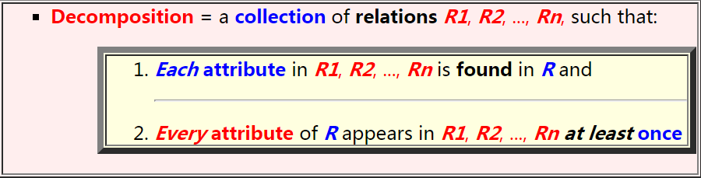
Decomposition and Its Effect on a Relation
Lecture 5 > Section 1 > Overview
A decomposition of a relation R is :
There are good and bad decomposition
In other words:
A decomposition will not lose any attributes from the original relation
Notes:
That is, for any attribute A ε X, (X − {A}) does not functionally determine Y.
A functional dependency X → Y is a partial dependency if some attribute A ε X can be removed from X and the dependency still holds; that is, for some A ε X, (X − {A}) → Y.

Slide 37
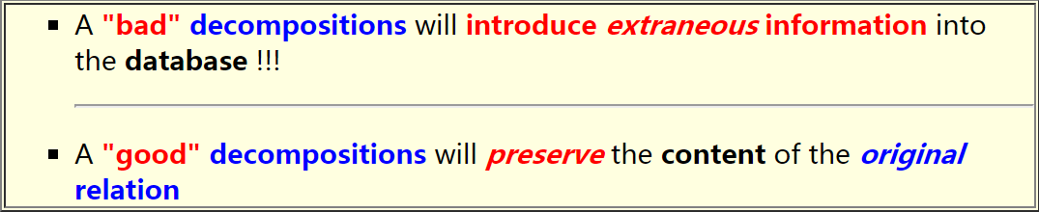
Decomposition and Its Effect on a Relation (cont.)
Lecture 5 > Section 1 > Overview
There are "good" and "bad" decompositions
We will soon see that
Notes:
That is, for any attribute A ε X, (X − {A}) does not functionally determine Y.
A functional dependency X → Y is a partial dependency if some attribute A ε X can be removed from X and the dependency still holds; that is, for some A ε X, (X − {A}) → Y.

Slide 38
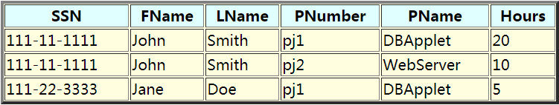



The Effect of a Decomposition
Lecture 5 > Section 1 > Overview
Consider the following content of the relation Employee1:
The content of the relation Employee1 convey the following facts:
There are 2 employees
There are 2 projects
There are 3 "works_on" information items:
Notes:
That is, for any attribute A ε X, (X − {A}) does not functionally determine Y.
A functional dependency X → Y is a partial dependency if some attribute A ε X can be removed from X and the dependency still holds; that is, for some A ε X, (X − {A}) → Y.

Slide 39

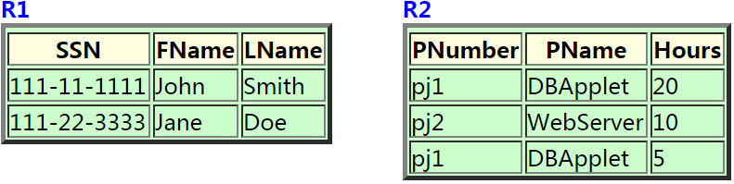
The Effect of a Decomposition (cont.)
Lecture 5 > Section 1 > Overview
Go back to our previous example:
Now populate R1 and R2 using the data in Employee1:
Therefore, the content of the decomposed relations R1 and R2 will be:
A decomposition for Employee1(SSN, FName, LName, PNumber, PName, Hours)
R1(SSN, LName, FName)
R2(PNumber, PName, Hours)
Notes:
That is, for any attribute A ε X, (X − {A}) does not functionally determine Y.
A functional dependency X → Y is a partial dependency if some attribute A ε X can be removed from X and the dependency still holds; that is, for some A ε X, (X − {A}) → Y.

Slide 40
The Effect of a Decomposition (cont.)
Lecture 5 > Section 1 > Overview
Note:
After the decomposition of Employee1 into R1 and R2, the relation Employee1 is deleted !!!
An important question to ask is:
Can we obtain the same information stored in Employee1 from the relations R1 and R2 ?
(If not, we will be in deep trouble)...
Notes:
That is, for any attribute A ε X, (X − {A}) does not functionally determine Y.
A functional dependency X → Y is a partial dependency if some attribute A ε X can be removed from X and the dependency still holds; that is, for some A ε X, (X − {A}) → Y.

Slide 41
Reconstructing the Original Content of a Decomposed Relation
Lecture 5 > Section 1 > Overview
The reconstruction algorithm used is as follows:
if ( R1 ∩ R2 != ∅ )
{
reconstruction = R1 ⋈ R2 // Join
}
else
{
reconstruction = R1 × R2 // Cartesian product
}
Notes:
That is, for any attribute A ε X, (X − {A}) does not functionally determine Y.
A functional dependency X → Y is a partial dependency if some attribute A ε X can be removed from X and the dependency still holds; that is, for some A ε X, (X − {A}) → Y.

Slide 42
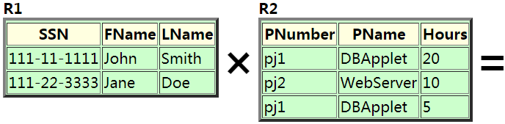
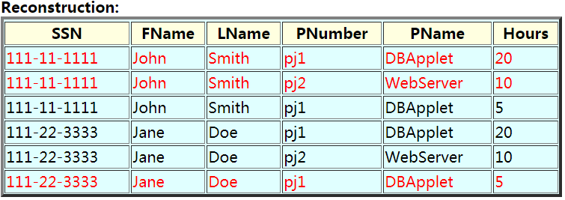
Reconstructing the Original Content of a Decomposed Relation (Example)
Lecture 5 > Section 1 > Overview
Notes:
That is, for any attribute A ε X, (X − {A}) does not functionally determine Y.
A functional dependency X → Y is a partial dependency if some attribute A ε X can be removed from X and the dependency still holds; that is, for some A ε X, (X − {A}) → Y.

Slide 43
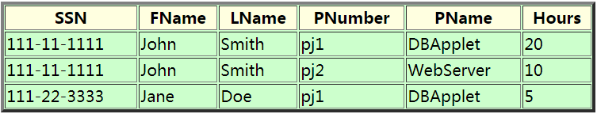
Reconstructing the Original Content of a Decomposed Relation (Example) (cont.)
Lecture 5 > Section 1 > Overview
Compare the content of the reconstruction to the content of the original Employee1 relation:
Notes:
That is, for any attribute A ε X, (X − {A}) does not functionally determine Y.
A functional dependency X → Y is a partial dependency if some attribute A ε X can be removed from X and the dependency still holds; that is, for some A ε X, (X − {A}) → Y.

Slide 44
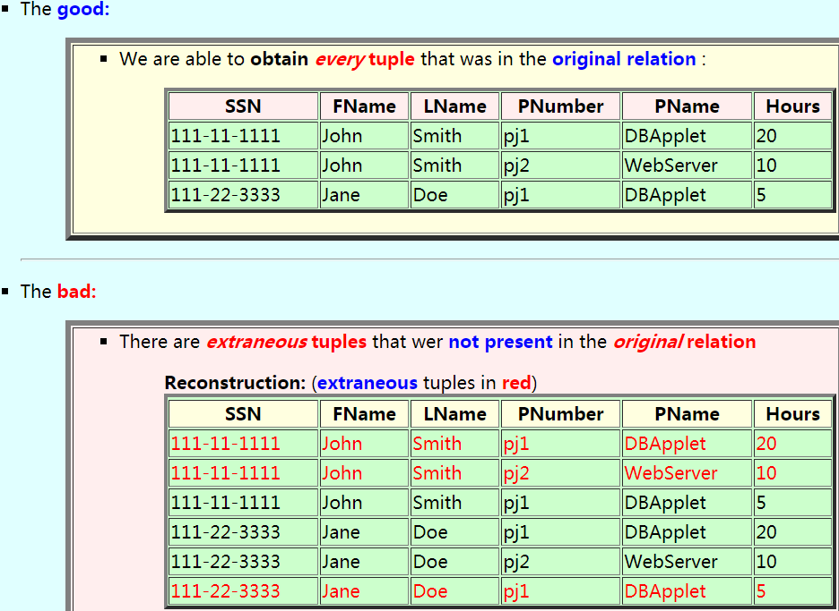
Lecture 5 > Section 1 > Overview
Notes:
That is, for any attribute A ε X, (X − {A}) does not functionally determine Y.
A functional dependency X → Y is a partial dependency if some attribute A ε X can be removed from X and the dependency still holds; that is, for some A ε X, (X − {A}) → Y.

Slide 45
Requirements of a decomposition
Lecture 5 > Section 1 > Overview
After decomposing a relation R:
We must be able to obtain all tuples in the original relation R using the reconstruction algorithm
We must not obtain extraneous tuples that were not present in the original relation R using the reconstruction algorithm
Notes:
That is, for any attribute A ε X, (X − {A}) does not functionally determine Y.
A functional dependency X → Y is a partial dependency if some attribute A ε X can be removed from X and the dependency still holds; that is, for some A ε X, (X − {A}) → Y.

Slide 46
Requirements of a decomposition (cont.)
Lecture 5 > Section 1 > Overview
If we miss some tuples in the reconstruction, it means that:
We have lose information
Clearly that is unacceptable!!!
If we gain some (extraneous) tuple in the reconstruction, it means that:
We have some invalid information in the relation (= database) !!!
That is also inacceptable !!!
Notes:
That is, for any attribute A ε X, (X − {A}) does not functionally determine Y.
A functional dependency X → Y is a partial dependency if some attribute A ε X can be removed from X and the dependency still holds; that is, for some A ε X, (X − {A}) → Y.

